Slide 1


Robian19 Line Following Robots
Presented by: Dr. Omar Ahmad

Slide 2
Overview
Part 1: Robian19 Introduction
  Robian19 Theme and Arena
  Scoring System
  Dates and Venue
  Registration for Robian19
Part 2: Robot Design
  Introduction to design of main PCB
  Making the Robot chassis
  Choosing Motors
Part 3: Sensing requirements
  Sensor board for line sensing
  Calibrating sensors
  Getting deviation error from line sensors
  Color sensor module TCS3200

Slide 3
Part 1: Robian19 Introduction

Slide 4
Robian19 Arena & Theme

Slide 5
Scoring System
No | Task Description | Points
1. | Robot moving and sensing | 10
2. | Successfully marking a check point (4 checkpoints) | 10 x 4
3. | Successfully complete 1st round of outer circle. | 10
4. | Successfully detect and enter the correct turning point to the inner circle. | 15
5. | Stop at the end point. | 5
6. | Completion time bonus = (30 – 0.25 * seconds to complete track), Zero if robot takes more than 120 seconds | 30
 | Total | 110

Slide 6
Dates and Venue for Robian19
Dates:
  Saturday 7th December 2019 (Qualification Rounds)
  Monday 9th December 2019 (Finals)
Venue:
  Seminar Hall, CUI Islamabad

Slide 7
Registration for Robian19
Register as teams:
  No more than 3 members per team.
Registration Fee:
  PKR 1500/- per team
What you will get?
  Free training sessions (seminars/workshops)
  Robot Main Board (PCB) to get you started.
  Certificates of participation
  Refreshments

Slide 8


Contact:
Sir Imran Lodhi (Head Robian19)
  Room G02. ECE Department
Dr. Omar Ahmad (Head Technical Committee)
  Room 330. ECE Department

Slide 9
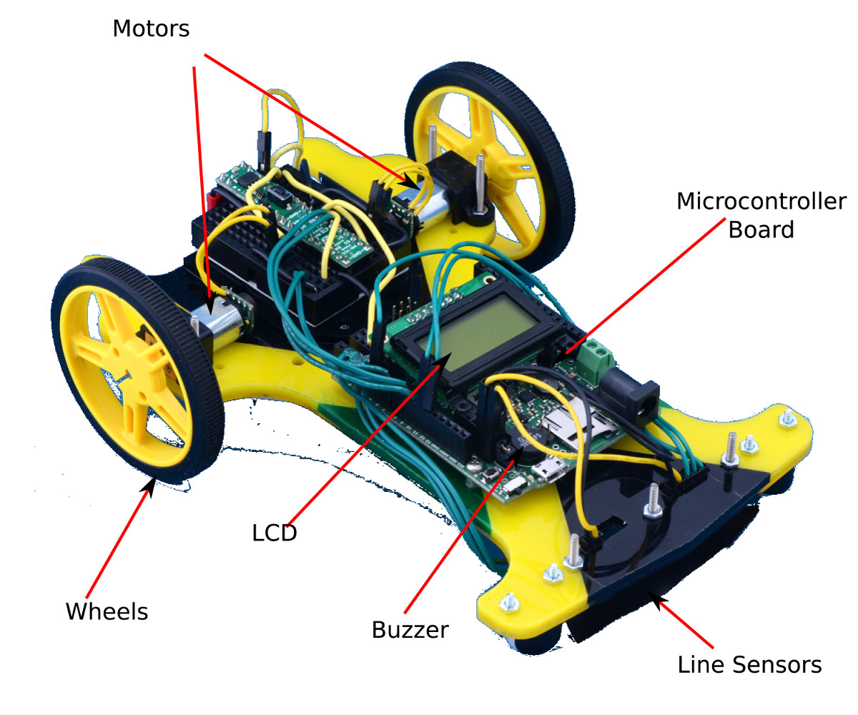
Part 2: Robot Design

Slide 10
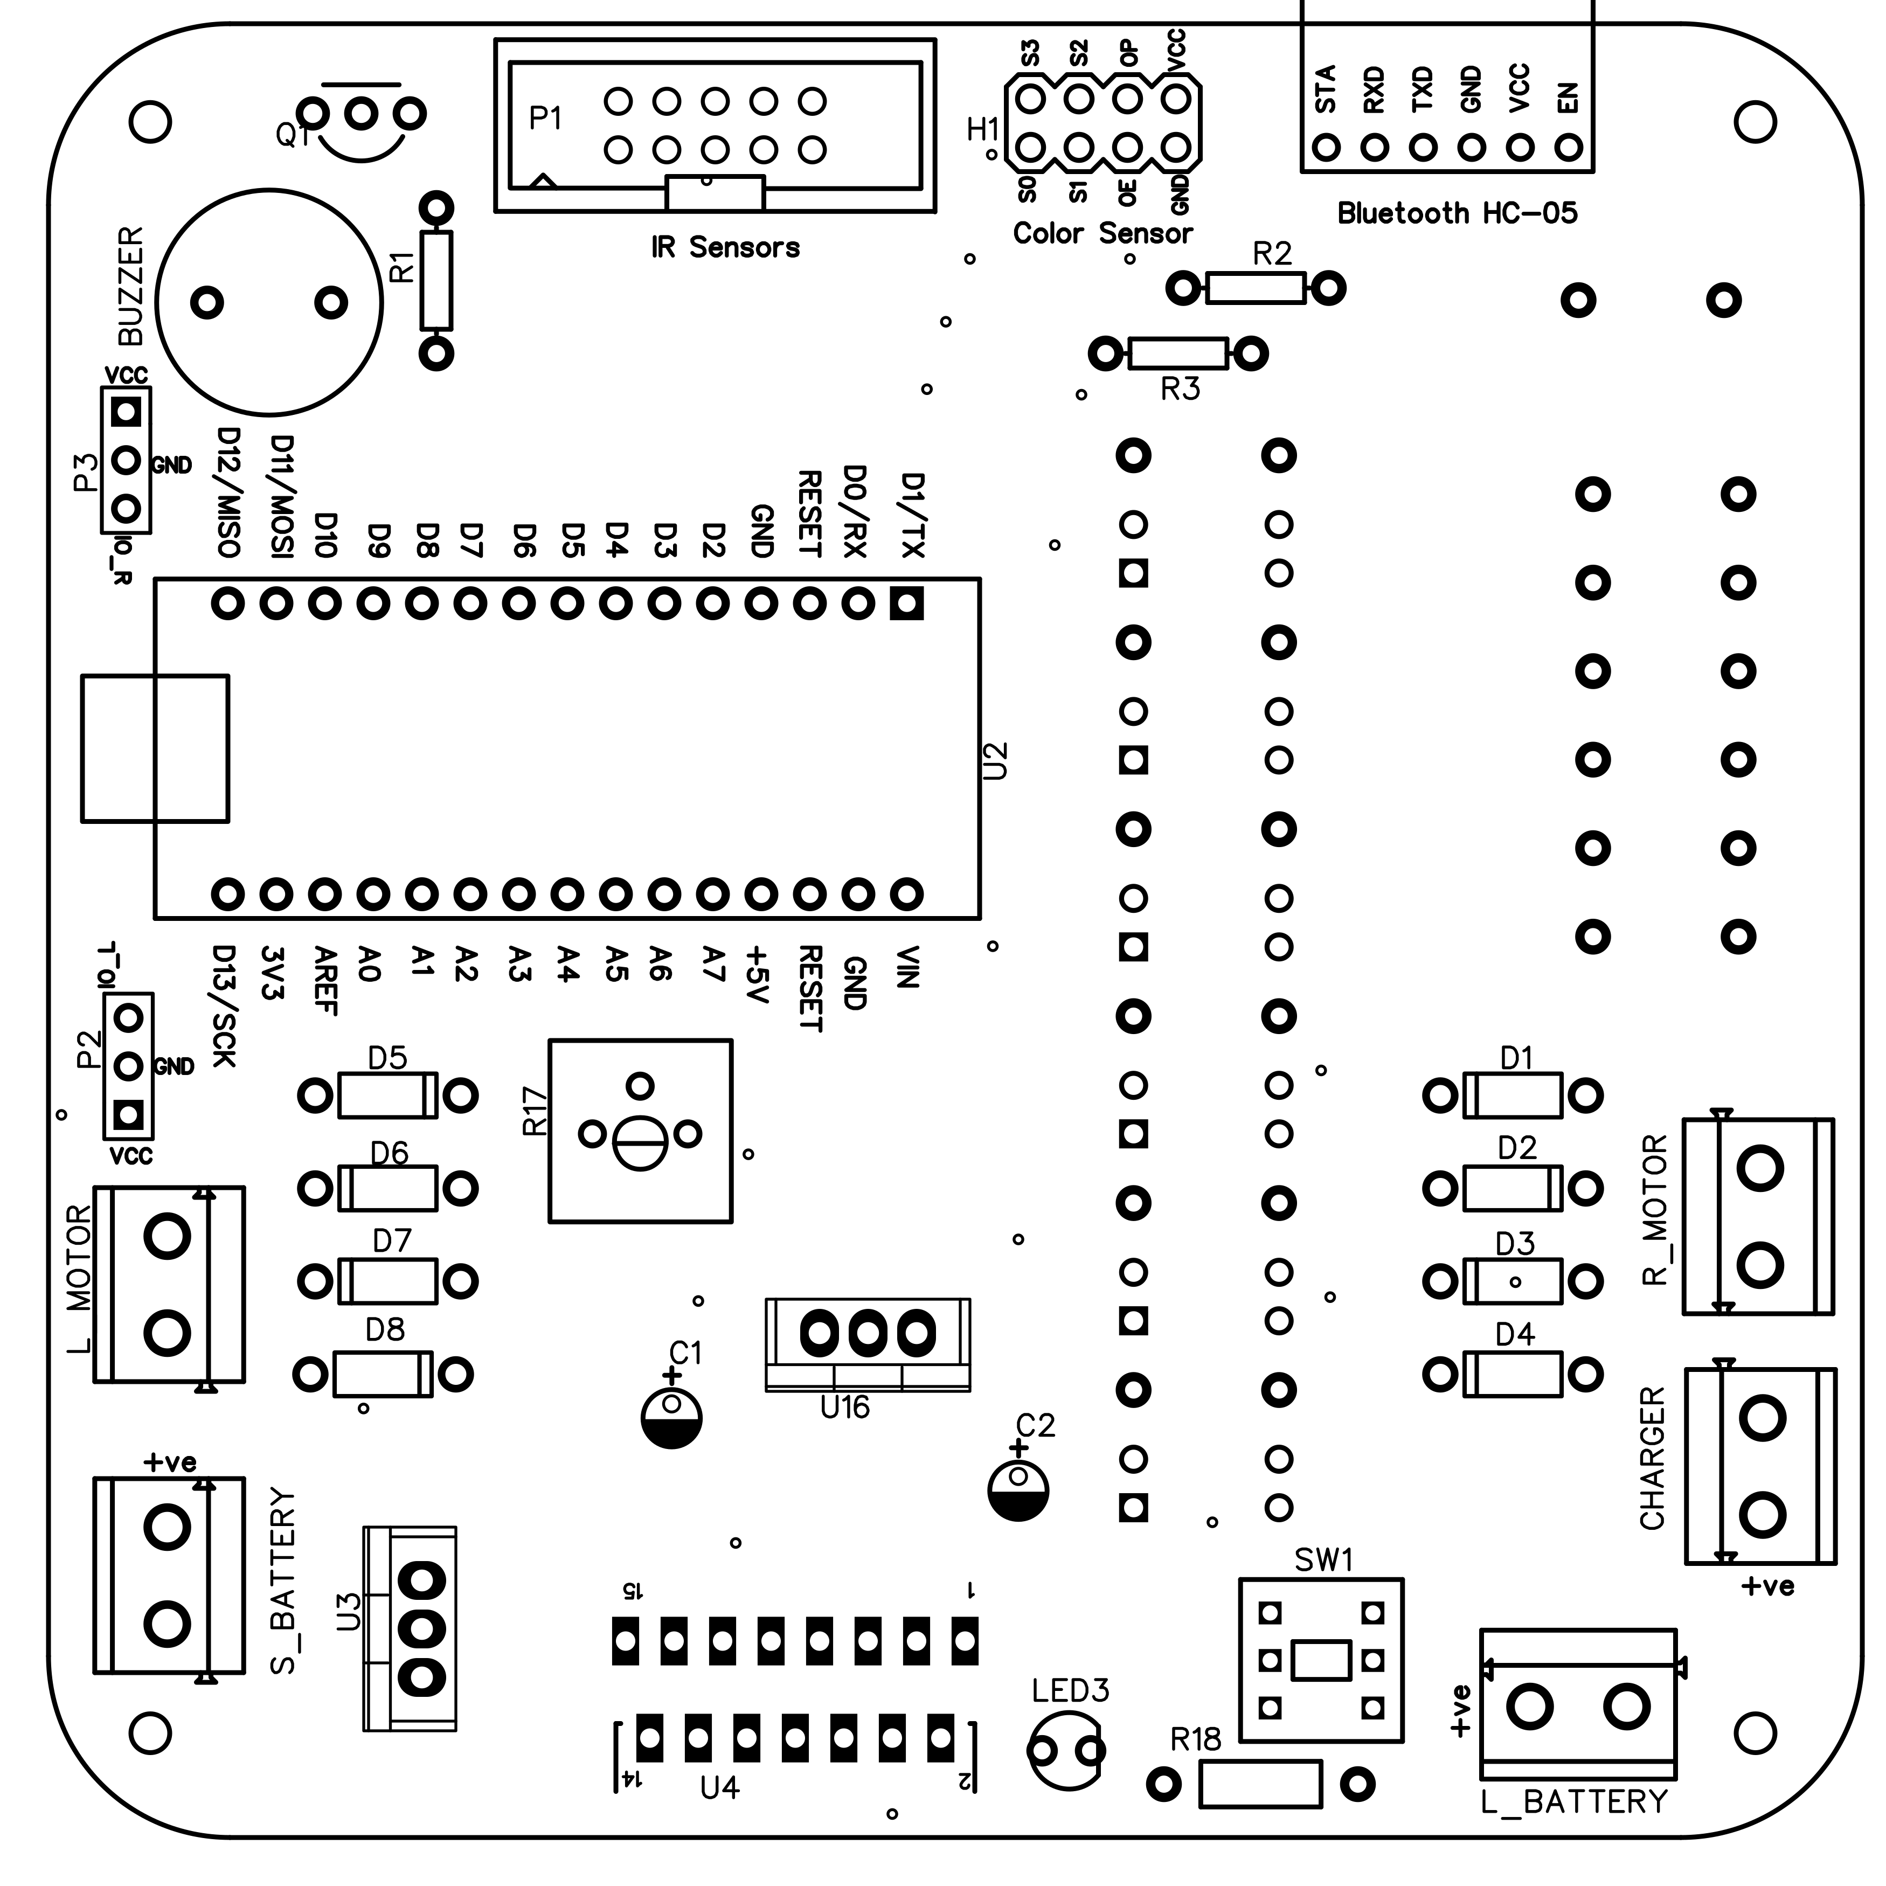
Design of The Main PCB

Slide 11
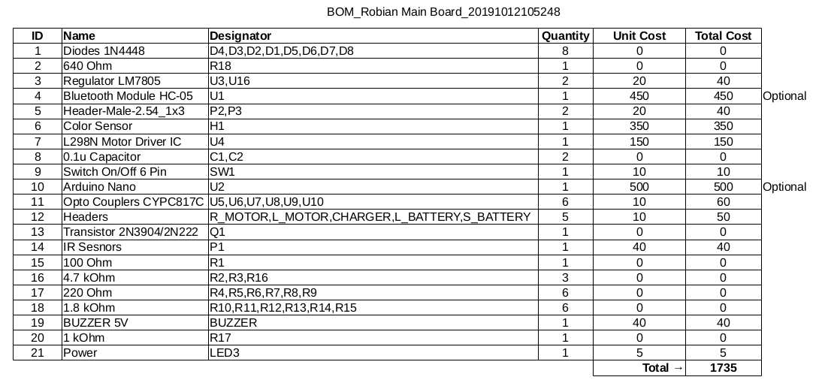
Part List for Main Board

Slide 12
The Robot Chassis
Use a DIY type off the shelf kit
  Easy and ready-made
  Restricted in choice of motors and wheels etc
Modify a toy car?
  Cost effective if you have one already
  Ackerman Drive
Make one your self (highly recommended)
  Cost effective
  Spend on good motors
  Good motors are generally difficult to get and then need coupling with wheels
http://www.maerivoet.org/website/software/arduino/manuals/electronics/robot-builders-bonanza.pdf

Slide 13
The Robot Chassis: Material Choice
Wood ?
  Saw, Drill, Glue nails etc will be needed
Plastic?
  Cutter, Drill, Screws, Magic Depoxy etc will be needed
Modify a Toy?
  Screw Driver, Cutter, etc

Slide 14
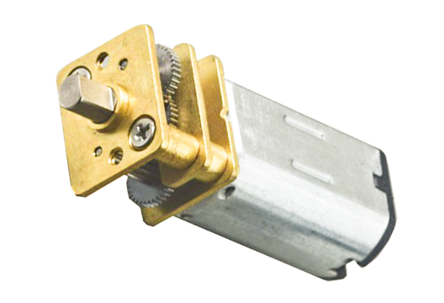
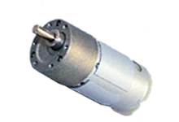
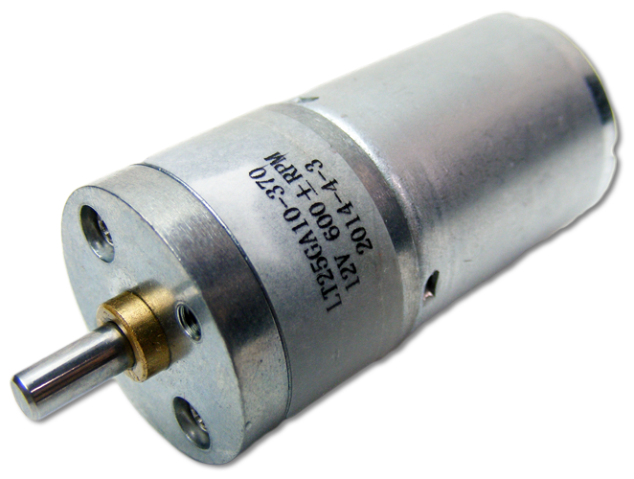
Choosing Motors
Important motor parameters:
Rated voltage
Rated RPM
Continuous torque
Gear ratio
https://www.robotshop.com/blog/en/drive-motor-sizing-tool-9698
https://www.groschopp.com/understanding-continuous-speed-in-dc-motor-applications/

Slide 15
Part 3: Sensing Requirements

Slide 16
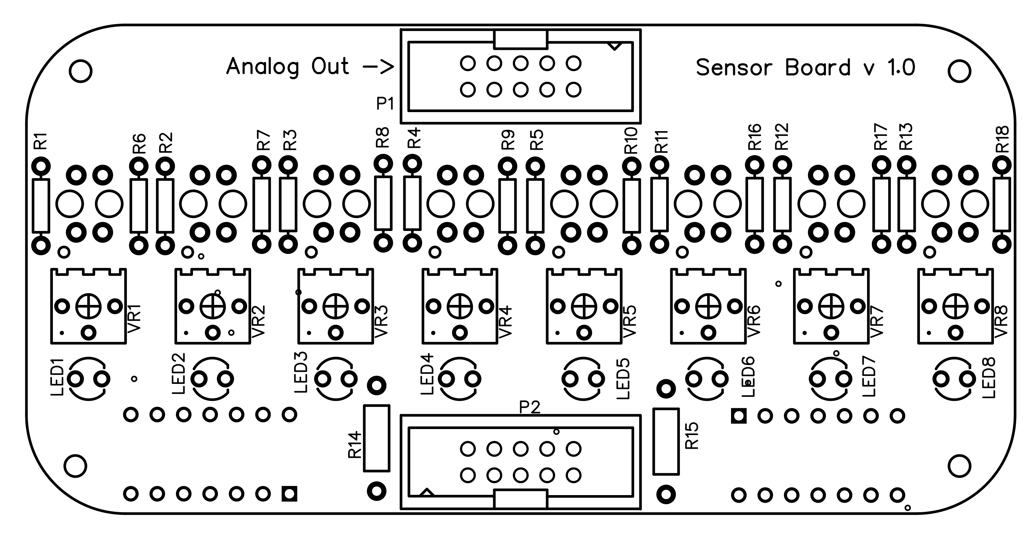
Sensor Board for Robian19

Slide 17
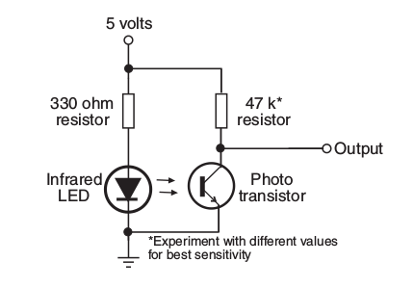
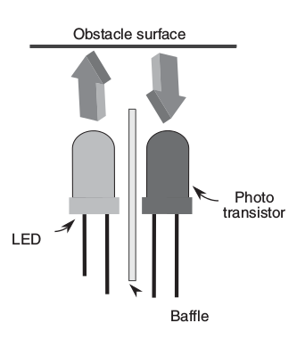
Sensors for Line Following
Most sensors usually provide analog outputs that can be connected to the ADC of a microcontroller

Slide 18
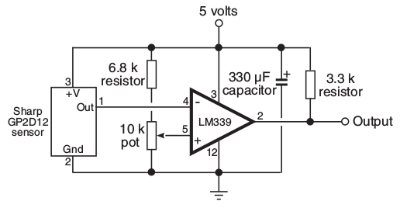
Sensors for Line Following
Alternatively this output can be fed to an amplifier and then connected to a digital IO pin of the microcontroller.
Which approach is better?

Slide 19
Analog vs Digital Interface
Digital Interface is
  Easy
  Fast response
  Needs Manual Calibration
Analogue Interface
  Needs design choices
  Has slower response?
  But can be calibrated by software

Slide 20
Analog Sensor Calibration
Outputs from the analog sensors are in the range (0 to 1023).
  value = analogRead(channel);
You will have multiple sensors for line sensing and you will need to calibrate each one individually!!
What is sensor calibration?
Finding threshold values for the two cases (Why 2 thresholds?)
  Sensor on the line
  Sensor off the line

Slide 21
Auto-Calibration of Analog Sensors
The robot starts calibrating its sensors when commanded (e.g. on a button press).
Move the sensors over the line while the MCU records values in arrays
Calculate the thresholds
Save the thresholds in EPROM and load them in future.
  Include EEPROM.h
  Use functions EEPROM.get(), EEPROM.get()

Slide 22
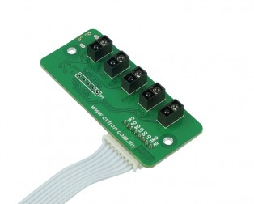
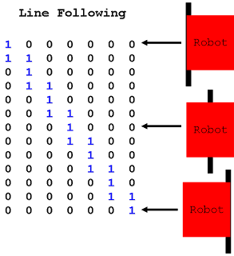
Decisions Based on Line Sensor Output

Slide 23
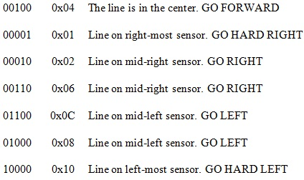
Decisions Based on Line Sensor Output
Issue different control commands to the robot based on the binary pattern of the sensor array
if((LFSensor[0]== 0 )&&(LFSensor[1]== 0 )&&(LFSensor[2]== 0 )&&(LFSensor[3]== 0 )&&(LFSensor[4]== 1 ))
GoHardRight();

Slide 24
Issues With This Approach
Leads to cluttered code.
A very small set of control commands do not allow robust line following
The robot oscillates about the line (zig-zag motion)and often loses the line

Slide 25
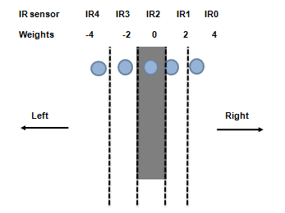
A Better Approach
Assign weights to each sensor and using a formula calculate a numeric ‘Error’ value
https://www.mathworks.com/help/supportpkg/arduino/examples/arduino-robot-line-follower-application.html?prodcode=SL

Slide 26
Benefits of this Approach
Now we have one numeric position ‘Error’ value which is positive if the robot deviates to the right (e.g.) and negative when it deviates to the left!
The magnitude is proportional to the deviation
Easier to code and making the program more elegant!!
Last but not the least it can be fed to our PID controller

Slide 27
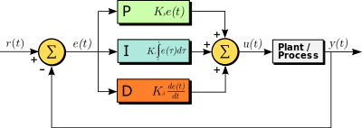

What is PID Controller?
A Proportional–Integral–Derivative (PID) controller is a control loop feedback mechanism (controller) commonly used in industrial control systems. A PID controller continuously calculates an error value e(t) as the difference between a desired setpoint and a measured process variable y(t)and applies a correction based on proportional, integral, and derivative terms (sometimes denoted P, I, and D respectively) which give their name to the controller type.

Slide 28
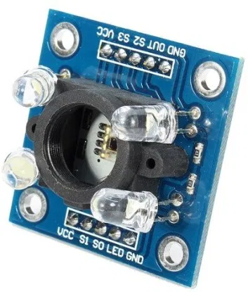
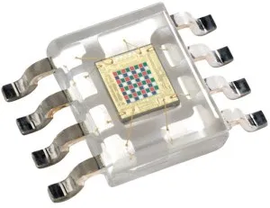
Color Sensor TCS3200

Slide 29
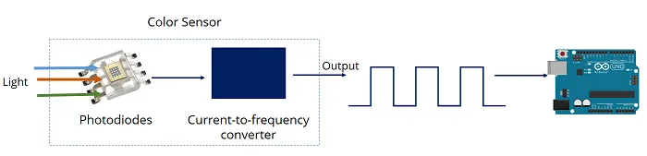
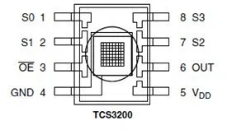
Color Sensor Interfacing
https://randomnerdtutorials.com/arduino-color-sensor-tcs230-tcs3200/

Slide 30
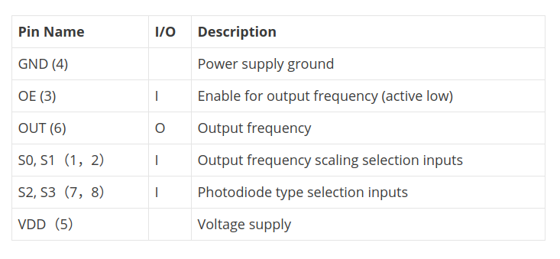
Color Sensor Interfacing

Slide 31
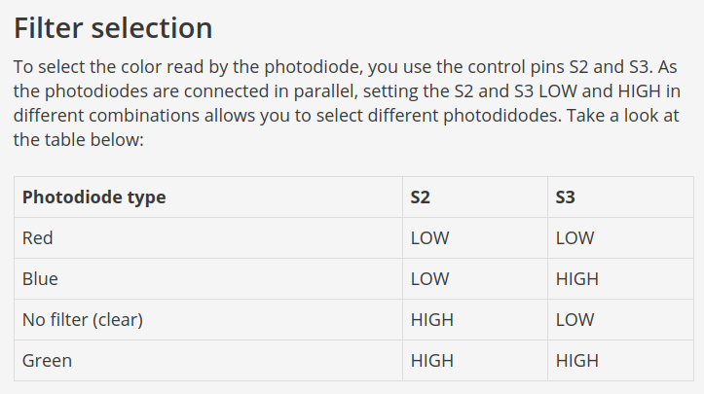
Color Sensor Interfacing

Slide 32
Color Sensor Interfacing
Part of your Complex Engineering Problem

Slide 33
References
https://www.mouser.com/catalog/specsheets/TCS3200-E11.pdf
https://howtomechatronics.com/tutorials/arduino/arduino-color-sensing-tutorial-tcs230-tcs3200-color-sensor/
https://randomnerdtutorials.com/arduino-color-sensor-tcs230-tcs3200/
https://github.com/MajicDesigns/MD_TCS230
https://github.com/CloudyPadmal/TCS3200_Color_Sensor/blob/master/Color/Color.cpp

